Slide 1
Project on
Employee Attrition Analysis
HR Analytics Project
NAME | Enrollment No.
Apurvasingh Chauhan | 20251007
Astha Singh | 20251009
Swasti Agrawal | 20251052
Chirag Ubhadiya | 20251014
Ruchit Vaghasiya | 20251045

Slide 2
Project Objective
1. Understand Employee Attrition Patterns
  Analyze why employees are leaving the organization
  Identify common reasons across departments
2. Department-wise Attrition Analysis
  Determine which departments face higher employee exits
  Compare average tenure across departments
3. Demographic Impact on Attrition
  Study attrition trends based on gender
  Analyze experience level at the time of exit
4. Data-Driven HR Decision Support
  Convert raw HR data into actionable insights and enable management to take preventive retention measures

Slide 3
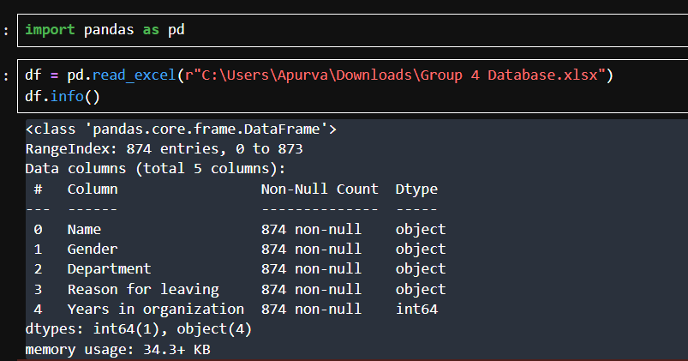
Dataset Overview

Slide 4
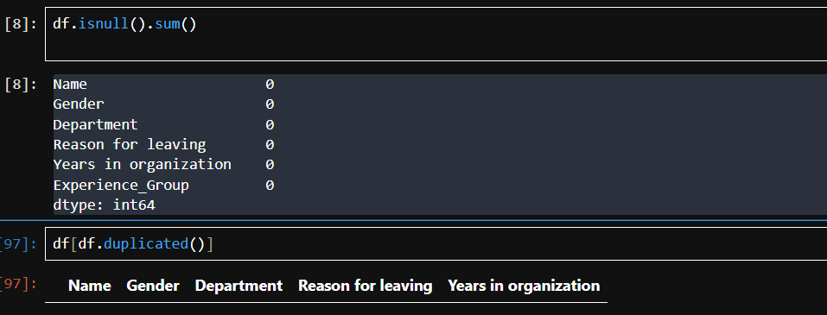
Data Validation and Integrity
Verified absence of duplicate and missing/null employee records

Slide 5
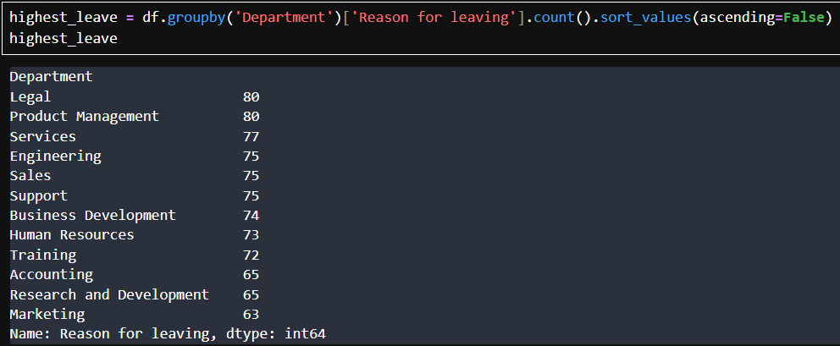
Data Analysis
Legal and Product Management departments show the highest number of employee exits

Slide 6
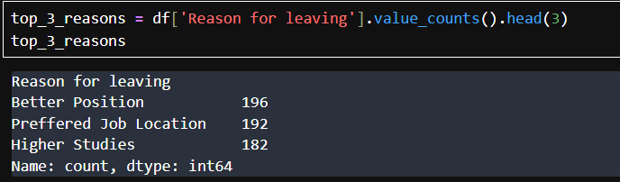
Data Analysis
Better Position, Preferred Job Location, and Higher Studies being the top three reasons employees leave the organization.

Slide 7


Microsoft Power BI

Slide 8
Microsoft Power BI

Slide 9
Key Findings
Sales and Support departments show higher employee attrition
Better salary and career growth are the most common reasons for leaving, indicating employees seek improved compensation and clearer advancement opportunities
Employees with 0–3 years of experience show higher exit rates, suggesting early-stage employees are more likely to switch roles or explore better opportunities.
Average tenure varies significantly across departments
Gender-based attrition shows balanced exits, indicating that attrition is more role-driven rather than influenced by gender.

Slide 10
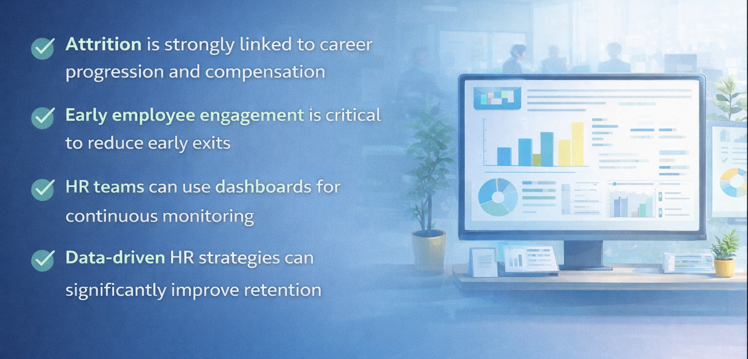
Conclusion

Slide 11

Thank You
Thank You

